Slide 1
Social Media Analysis
Mohit Yadav
1-10-2025

Slide 2
Problem Statement
You are hired as a data analyst at Meta and asked to collaborate with Marketing team. Marketing teams wants to leverage Instagram's user data to develop targeted marketing strategies that will increase user engagement, retention, and acquisition. Provide insights and recommendations to address the following objectives

Slide 3
Data Overview
comments_id : unique identifier for each comment
comment_text : text content of a given comment
user_id : unique identifier for each user
photo_id : unique identifier for each photo
created_at : date of interaction in the form like, photos, tags
follower_id : user_id of the follower for a certain user
followee_id : user_id of followee for a certain user
tag_id : unique identifier for each tag
image_url : link to the image posted on the platform
username : username chosen by the user

Slide 4
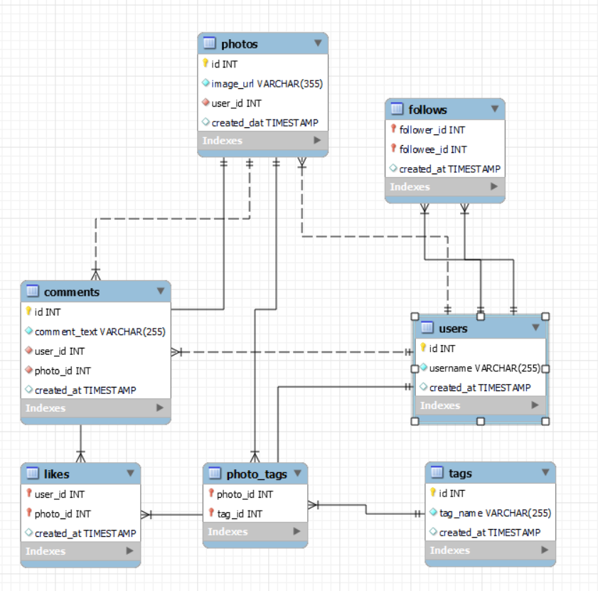
Database Schema

Slide 5
User Engagement Analysis: Insights on Likes, Comments, and Tags
Comments dominate engagement, likes strongly correlate, while photo tags remain underutilized and need promotion.
High-engagement users drive discussions, while low-activity users require targeted strategies to boost participation.

Slide 6
Trending Hashtags Analysis for Targeted Advertising Strategies
Diverse trending hashtags highlight varied interests, enabling targeted marketing and boosting campaign effectiveness and engagement.
Top hashtags like smile, beach, party, fun show lifestyle content drives strong user engagement.

Slide 7
High-Engagement Hashtags: Insights for Content and Ad Strategy
Strategic hashtag use with optimized timing, cross-promotion, and recurring content maximizes reach and discovery.
Food, beauty, and photography hashtags drive high engagement, offering strong opportunities for campaigns and influencer collaborations.

Slide 8
Top Engaged Users: Monthly Engagement Insights & Trends
Engagement is calculated from likes, comments, and tags, with top users like Eveline95 driving activity.
Power users dominate engagement, presenting opportunities for influencer partnerships and growth-focused marketing strategies.

Slide 9
Most Engaging Hashtags: Top Tags with Highest Average Likes
"Dreamy," "beauty," and "stunning" lead in average likes, showing strong engagement with visually appealing content.
Aesthetic and lifestyle hashtags dominate, offering brands and creators opportunities to boost visibility and interaction.

Slide 10
Re-Engaging Inactive Users: Strategies to Boost Platform Activity
23% of users have zero engagement, receiving no likes or comments despite posting content.
Personalized campaigns, ads, and incentives can re-engage inactive users, boosting overall platform activity.

Slide 11
User Segmentation for Targeted Marketing and Personalized Engagement
User segmentation: 30% high, 34% medium, and 36% low engagement users needing re-engagement strategies.
Targeted marketing: high-engagement users receive exclusives, medium users get interactive ads, low users get re-engagement strategies.

Slide 12
Instagram Engagement Playbook: Strategies for Growth and Retention
User Engagement Strategies
Content Personalization: Tailor posts based on user demographics, interests, and behavior using Instagram Insights.
Hashtag Targeting & Influencer Collaborations: Leverage trending, relevant hashtags and partner with aligned influencers.
User Retention Strategies
Re-engagement Campaigns: Target inactive users with personalized Stories, Reels, and notifications.
User Journey & Loyalty Programs: Map behaviors to optimize experience and encourage engagement through rewards.
Additional Optimization Strategies
A/B Testing: Test content, hashtags, and targeting to identify the most effective strategies.
Sentiment & Competitor Analysis: Use feedback to refine approaches and learn from competitors to improve engagement.

Slide 13
Thank you

